Slide 1

Deployment

Slide 2
Objectives
Deploy a Watson Assistant chatbot to Facebook Messenger
Deployment

Slide 3
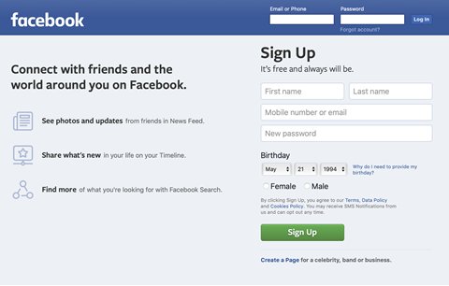
Deploying to Facebook Messenger
Create a Facebook Page and App
  Do by your self
Deployment

Slide 4
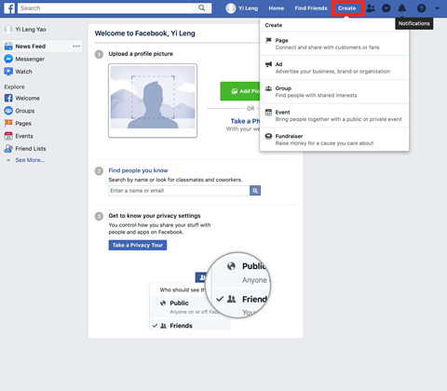
Deploying to Facebook Messenger
Create a Facebook Page to host your Watson Assistant Chatbot
Deployment

Slide 5
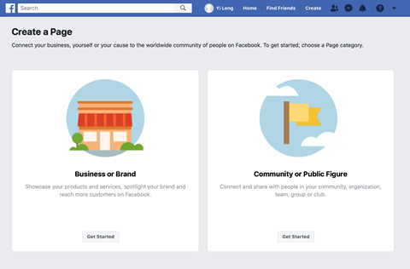
Deploying to Facebook Messenger
Select your category that you like
Deployment

Slide 6
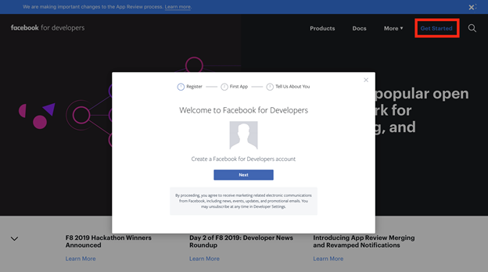
Deploying to Facebook Messenger
Create or login in your Facebook Developer account
Deployment

Slide 7
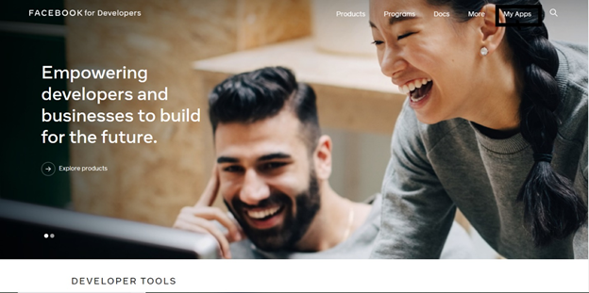
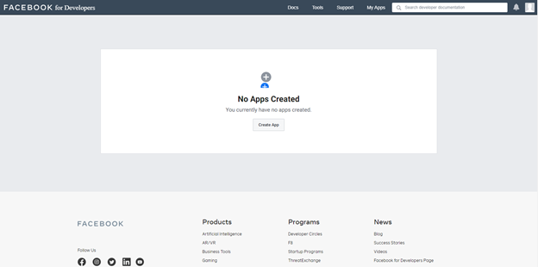
Deploying to Facebook Messenger
Create your Facebook App
Deployment

Slide 8
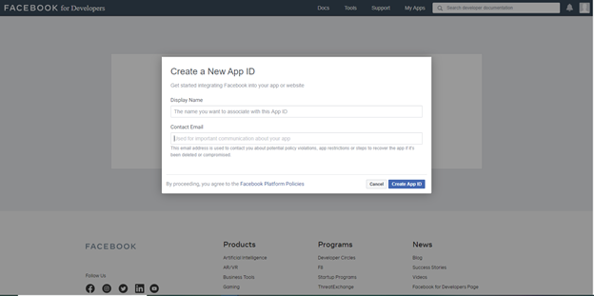
Deploying to Facebook Messenger
You'll be asked to fill in the Display Name and the Contact Email, fill the required details and click on Create App ID.
Deployment

Slide 9
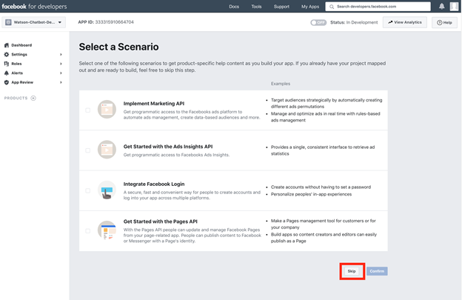
Deploying to Facebook Messenger
Select a scenario: just skip
Deployment

Slide 10
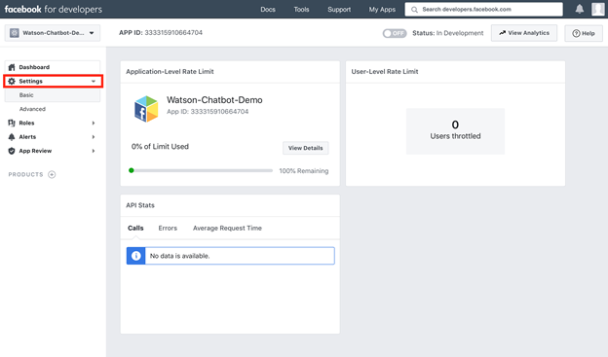
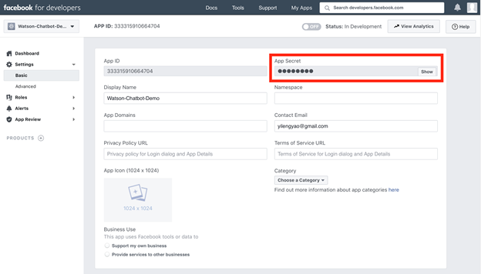
Deploying to Facebook Messenger
Setup App Secret for your Facebook app
Deployment

Slide 11
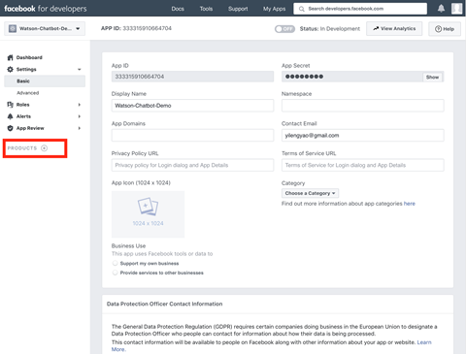
Deploying to Facebook Messenger
Connect Watson Assistant to our Facebook page.
Deployment

Slide 12
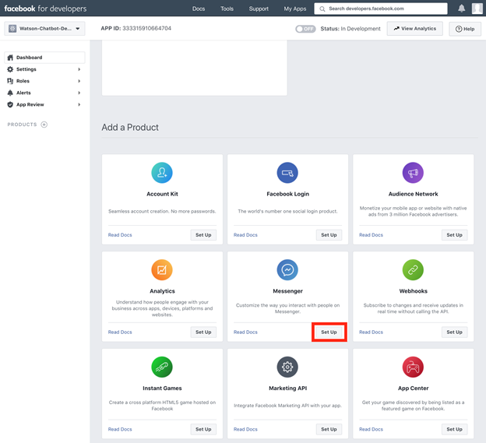
Deploying to Facebook Messenger
Scroll down to the Add a Product section. Click on Set Up under the Messenger option as shown below.
Deployment

Slide 13
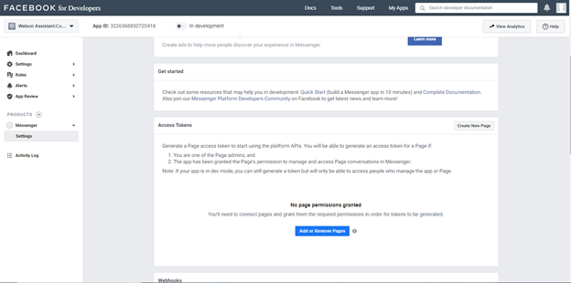
Deploying to Facebook Messenger
In the Access Tokens section click on Add or Remove Pages then click on Continue.
Deployment

Slide 14
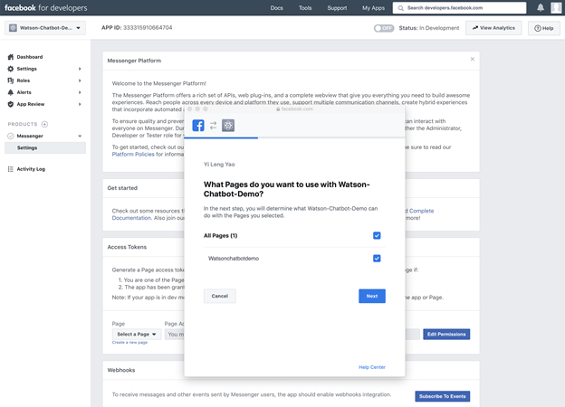
Deploying to Facebook Messenger
Select the Facebook page that you want to integrate your app
Deployment

Slide 15
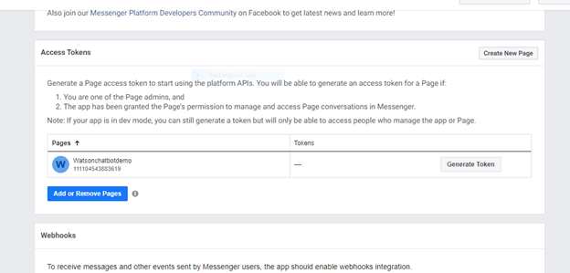
Deploying to Facebook Messenger
Generate the Page Access Token for your Facebook page. In the Access Tokens section click on Generate Token. Then save the Page Access Token.
Deployment

Slide 16
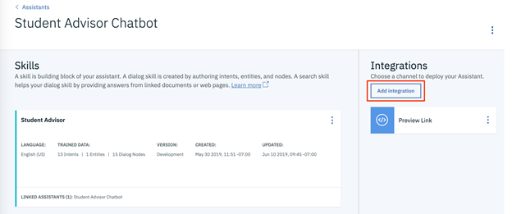
Deploying to Facebook Messenger
Integrate your Facebook App with Watson Assistant
1. Launch your Watson Assistant instance and click on the Assistants section. When there, select the Student Advisor Chatbot.
2. Click on the Add Integrations button on the right side of the page.
Deployment

Slide 17
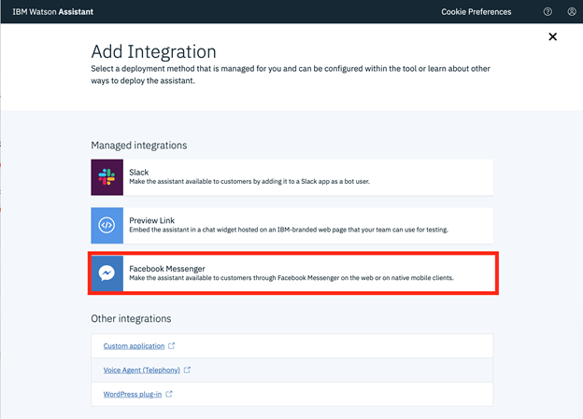
Deploying to Facebook Messenger
Select Facebook Messenger.
Deployment

Slide 18
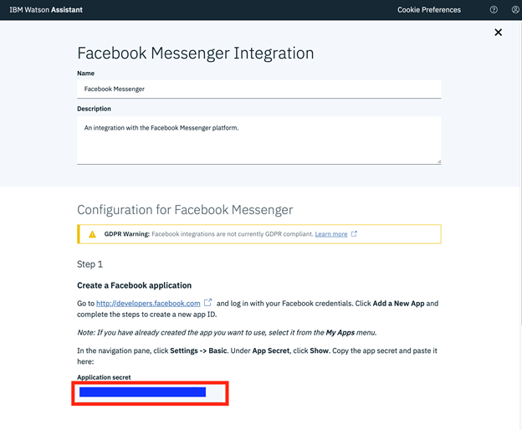
Deploying to Facebook Messenger
Paste the APP SECRET credentials of your Facebook App into the Application secret box.
Deployment

Slide 19
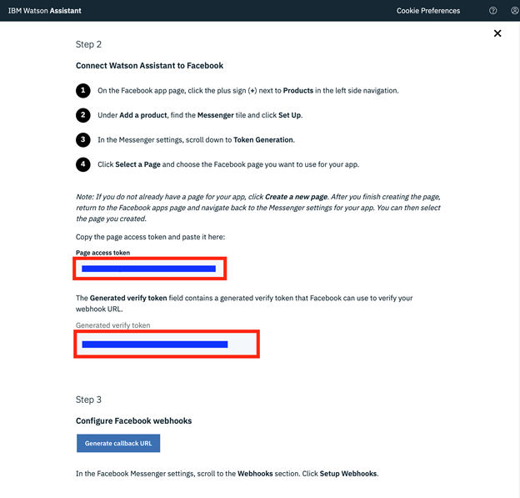
Deploying to Facebook Messenger
Proceed to Step 2 on the page, and paste the Page Access Token from your Facebook app in the Page access token box→ save the Generate verify token.
Deployment

Slide 20
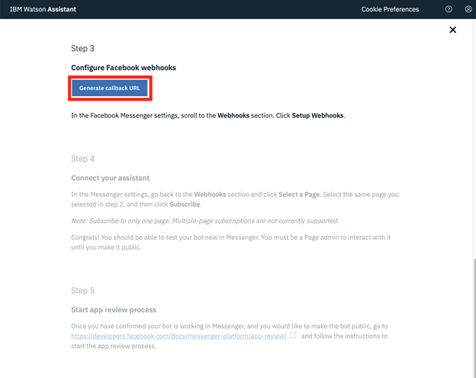
Deploying to Facebook Messenger
Proceed to Step 3. There, click on Generate callback URL and save your callback URL.
Deployment

Slide 21
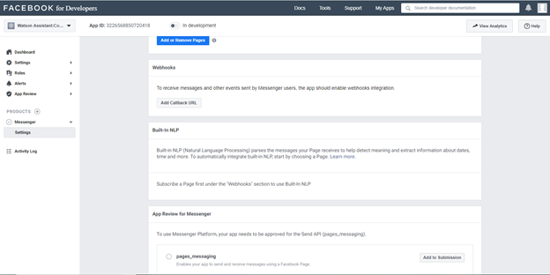
Deploying to Facebook Messenger
Go back to the page for your Facebook App
under the PRODUCTS section click on Settings. Then under the Webhooks section click on Add Callback URL.
Deployment

Slide 22
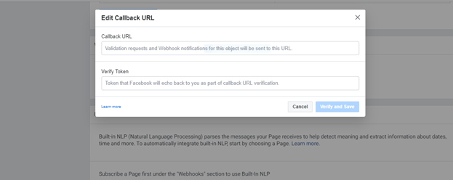
Deploying to Facebook Messenger
Paste the callback URL and Verify Token from your Watson Assistant. Then click Verify and Save
Deployment

Slide 23
Deploying to Facebook Messenger
Click on Add Subscription and select messages and messaging_postbacks. Then click save.
Deployment

Slide 24
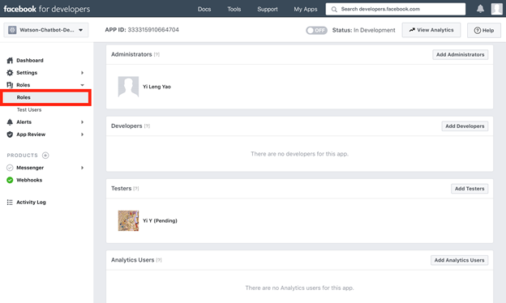
Deploying to Facebook Messenger
You can test your chatbot app on Messenger, go to the page for your Facebook app, click on Roles in the sidebar on the right. Then you add can add testers that can communicate with your chatbot during this testing phase.
Deployment

Slide 25
Summary
Deploy a Watson Assistant chatbot to Facebook Messenger
Deployment

Slide 26
Q & A
Deployment

